Slide 1
Sentiment Analysis of YouTube Comments
2410030138 KYASA GOWTHAM
2410030188 ANISH JADHAV
2410030320 V.MUKESH
2410030496 P.KARTHIKEYAN
2410030250 G.KISHORE

Slide 2
Visualizing Sentiment Results
Turning Data into Visual Stories
Effective visualization transforms raw sentiment scores into compelling narratives that stakeholders can instantly understand and act upon.
Bar charts reveal proportions of positive, neutral, and negative comments at a glance
Word clouds highlight frequently used words within each sentiment category, exposing themes
Scatter plots uncover relationships between sentiment intensity, comment length, and time patterns
Trend lines show sentiment evolution over hours or days after video release

Slide 3
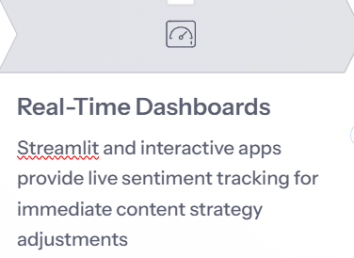
AI-Powered Enhancements
Modern AI tools take sentiment analysis beyond basic classification, enabling sophisticated interpretation and real-time insights that were impossible just years ago.

Slide 4
Business & Community Impact
Transforming Data into Action
Sentiment analysis bridges the gap between audience voice and strategic decision-making, creating measurable business value and stronger communities.

Slide 5
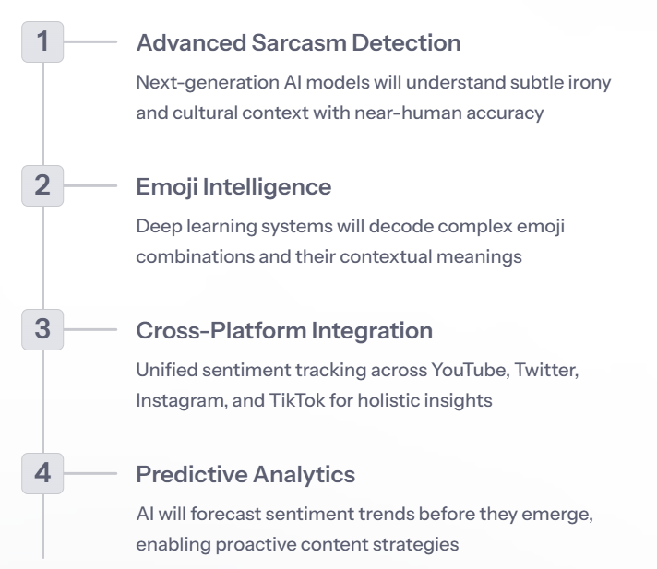
The Future of YouTube Sentiment Analysis

Slide 6
Thank you

